Slide 1
Lecture
Planning for Capital Investments
13
L.O. 25-1: Capital budgeting and cash payback method
L.O. 25-2: Net present value (NPV) method
L.O. 25-3: Capital budgeting challenges and refinements
L.O. 25-4: Internal rate of return (IRR) method
L.O. 25-5: Annual rate of return method

Slide 2
Learning Objective 25-1
Capital Budgeting and
Cash Payback Method

Slide 3
Outline
Capital budgeting process
Decision factors
Cash flow information
Cash payback period

Slide 4
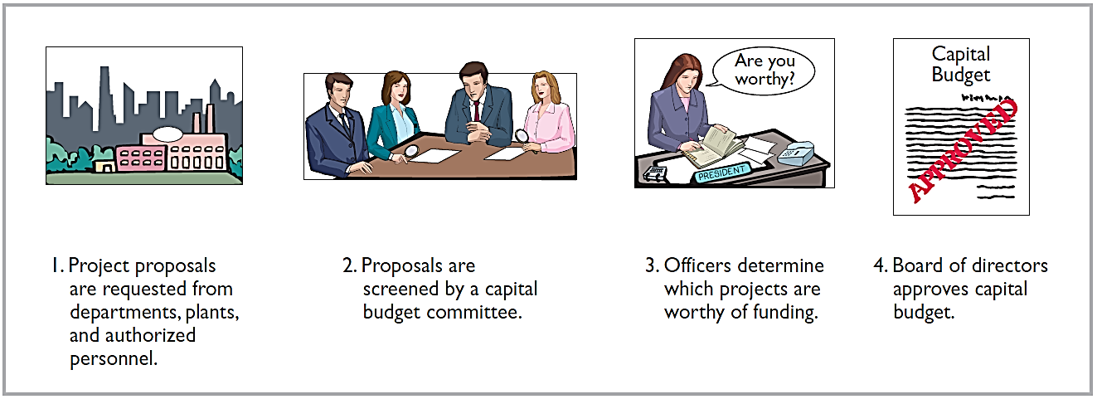
Authorization Process
Many companies follow a carefully prescribed process in capital budgeting.

Slide 5
Decision Factors
Capital budgeting decisions depend on:
Availability of funds.
Relationships among proposed projects.
Company’s basic decision-making approach.
Risk associated with a particular project.

Slide 6
Cash Flow Information
For purposes of capital budgeting, estimated cash inflows and outflows are the preferred inputs.
Why?
Ultimately, the value of all financial investments is determined by the value of cash flows received and paid.

Slide 7
Cash Flow Information
Typical cash flows relating to capital budgeting decisions.
Cash Outflows
Initial investment
Repairs and maintenance
Increased operating costs
Overhaul of equipment
Cash Inflows
Sale of old equipment
Increased cash received from customers
Reduced cash outflows related to operating costs
Salvage value of equipment

Slide 8
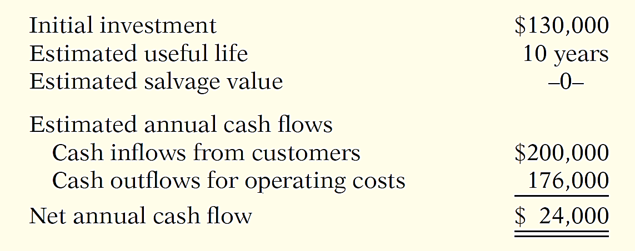
Illustrative Data
Stewart Shipping Company is considering an investment of $130,000 in new equipment.

Slide 9
Cash Payback
Cash payback technique identifies the time period required to recover the cost of the capital investment from the net annual cash inflow produced by the investment.
Assume equal net cash flows
Cash payback period for Stewart is …
$130,000 ÷ $24,000 = 5.42 years

Slide 10
Cash Payback
Shorter payback period = More attractive the investment
In the case of uneven net annual cash flows, the company determines the cash payback period when the:
Cumulative net cash flows from the investment
Cost of the investment
=

Slide 11
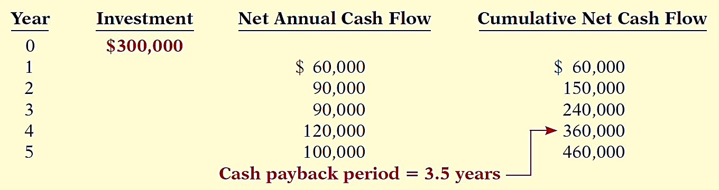
Cash Payback
Illustration: Chen Company proposes an investment in a new website that is estimated to cost $300,000.
Cash payback should not be the only basis for the capital budgeting decision as it ignores the expected profitability of the project.

Slide 12
DO IT! 1 Cash Payback Period
Watertown Paper Corporation is considering adding another machine for the manufacture of corrugated cardboard. The machine would cost $900,000. It would have an estimated life of 6 years and no salvage value. The company estimates that annual cash inflows would increase by $400,000 and that annual cash outflows would increase by $190,000. Compute the cash payback period.
8.00 years.
4.29 years.
5.00 years.
13.33 years.

Slide 13
Learning Objective 25-2
Net Present Value (NPV) Method

Slide 14
Outline
Basics of the net present value method
Equal annual cash flows
Uneven annual cash flows
Choosing a discount rate
Simplifying assumptions
Comparing discounted cash flows methods

Slide 15
Net Present Value (NPV) method
Cash inflows are discounted to their present value and then compared with the capital outlay required by the investment.
The interest rate used in discounting is the required minimum rate of return.
Proposal is acceptable when NPV is zero or positive.
The higher the positive NPV, the more attractive the investment.

Slide 16
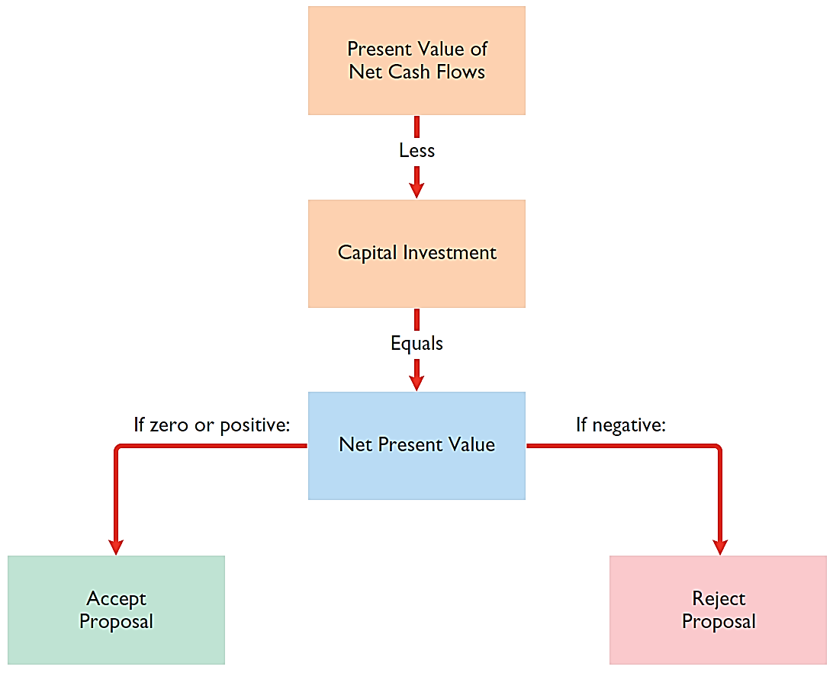
Net Present Value (NPV) method

Slide 17
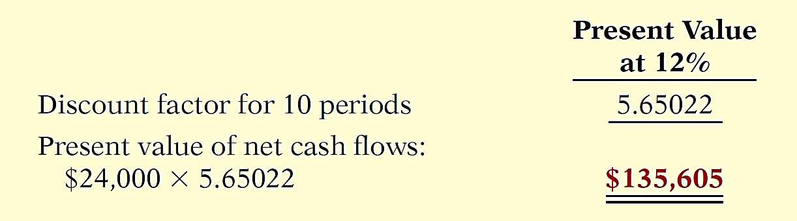
Equal Annual Cash Flows
Illustration: Stewart Shipping Company’s annual cash flows are $24,000. If we assume this amount is uniform over the asset’s useful life, we can compute the present value of the net annual cash flows.

Slide 18
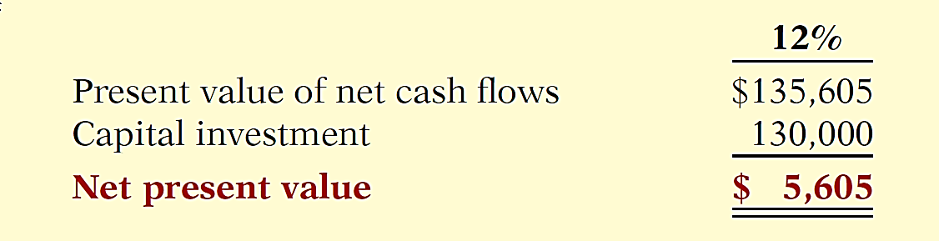
Equal Annual Cash Flows
Illustration: Calculate the present value.
The proposed capital expenditure is acceptable at a required rate of return of 12% because the net present value is positive.

Slide 19
Unequal Annual Cash Flows
Illustration: Stewart Shipping Company expects the same total net cash flows of $240,000 over the life of the investment. Because of a declining market demand for the new product the net annual cash flows are higher in the early years and lower in the later years.

Slide 20
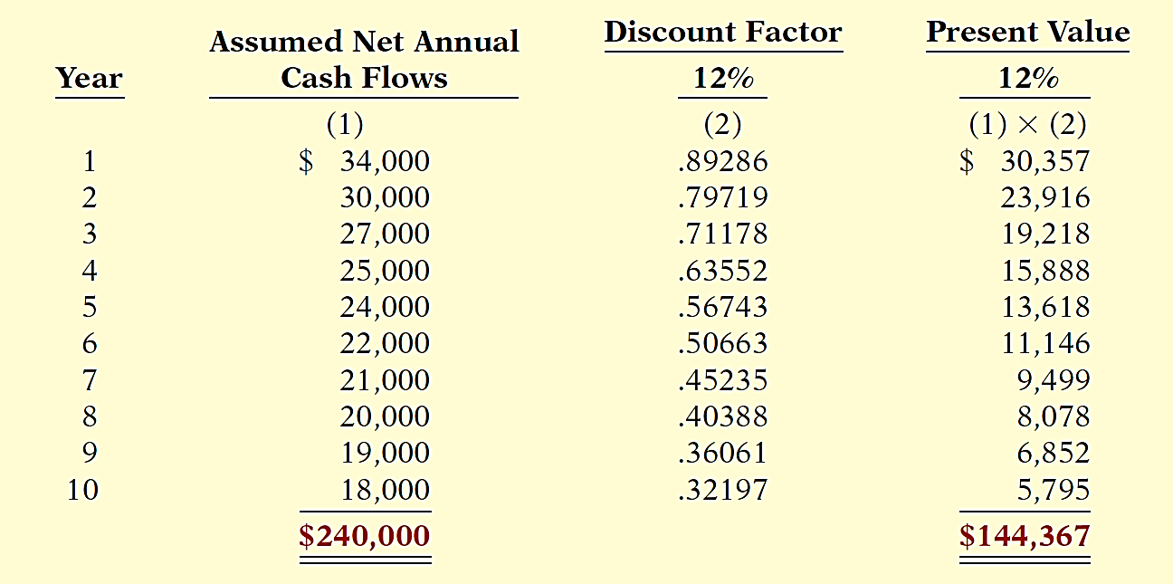
Unequal Annual Cash Flows

Slide 21
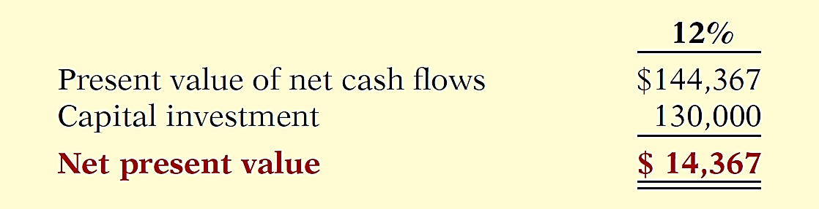
Unequal Annual Cash Flows
Illustration: Calculate the net present value.
Proposed capital expenditure is acceptable at a required rate of return of 12% because the net present value is positive.

Slide 22
Choosing a Discount Rate
In most instances a company uses a required rate of return equal to its cost of capital — that is, the rate that it must pay to obtain funds from creditors and stockholders.
Discount rate has two elements:
Cost of capital
Risk
Rate also know as
required rate of return.
hurdle rate.
cutoff rate.

Slide 23
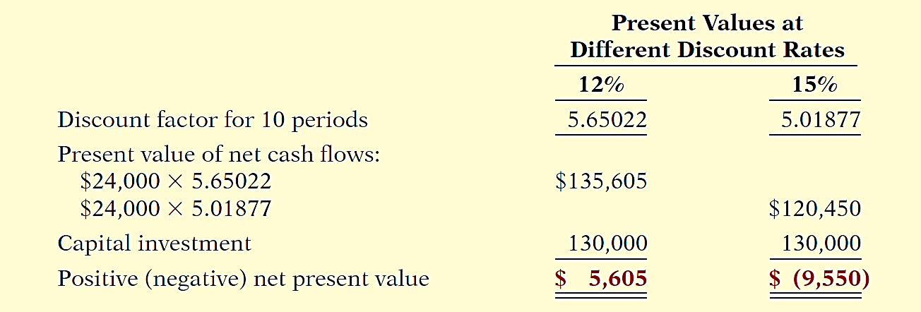
Choosing a Discount Rate
Illustration: Stewart Shipping used a discount rate of 12%. Suppose this rate does not take into account the risk of the project. A more appropriate rate might be 15%.

Slide 24
Simplifying Assumptions
All cash flows come at the end of each year.
All cash flows are immediately reinvested in another project that has a similar return.
All cash flows can be predicted with certainty.

Slide 25
Net Present Value (NPV) method
Question
Compute the net present value of a $260,000 investment with a 10-year life, annual cash inflows of $50,000 and a discount rate of 12%.
$(9,062).
$22,511.
$9,062.
$(22,511).

Slide 26
Comprehensive Example
Best Taste Foods is considering investing in new equipment to produce fat-free snack foods.
Initial investment | $1,000,000
Cost of equipment overhaul in 5 years | $200,000
Salvage value of equipment in 10 years | $20,000
Cost of capital (discount rate) | 15%
Estimated annual cash flows
Cash inflows received from sales | $500,000
Cash outflows for cost of goods sold | $200,000
Maintenance costs | $30,000
Other direct operating costs | $40,000

Slide 27
Comprehensive Example
Compute the net annual cash flows for this project.
Cash inflows received from sales | $ 500,000
Cash outflows for cost of goods sold | (200,000)
Maintenance costs | (30,000)
Other direct operating costs | (40,000)
Net annual cash flow | $ 230,000

Slide 28
Comprehensive Example
Compute the net present value for this proposed investment.
Event | Time Period | Cash Flow | × | 15% Discount Factor | = | Present Value
Net annual cash flow | 1-10 | $ 230,000 |  | 5.01877 |  | $1,154,317
Salvage value | 10 | 20,000 |  | .24719 |  | 4,944
Less: Equipment purchase | 0 | 1,000,000 |  | 1.00000 |  | 1,000,000
Less: Equipment overhaul | 5 | 200,000 |  | .49718 |  | 99,436
Net present value |  |  |  |  |  | $ 59,825

Slide 29
Learning Objective 25-3
Capital Budgeting
Challenges and Refinements

Slide 30
Outline
Intangible benefits
Profitability index for mutually exclusive projects
Risk analysis
Post-audit of investment projects

Slide 31
Capital Budgeting Challenges
Impact of intangible benefits.
Mutually exclusive projects.
Risk analysis.
Post-audit of investment projects.

Slide 32
Intangible Benefits
Intangible benefits might include increased quality, improved safety, or enhanced employee loyalty.
To avoid rejecting projects with intangible benefits:
Calculate net present value ignoring intangible benefits.
Project rough, conservative estimates of the value of the intangible benefits, and incorporate these values into the NPV calculation.

Slide 33
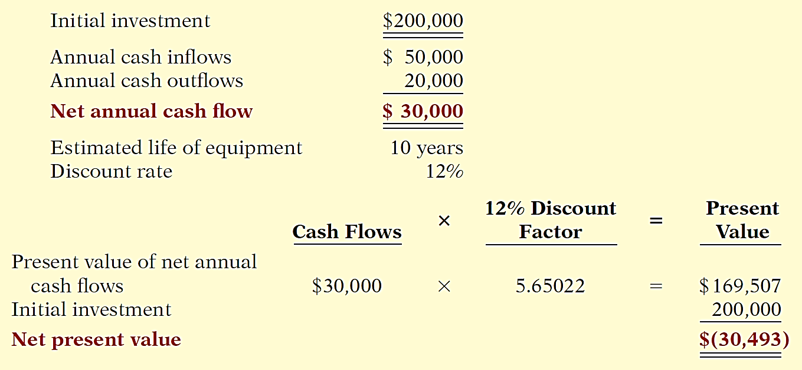
Intangible Benefits
Illustration: Berg Company is considering the purchase of a new mechanical robot.
Based on the negative net present value of $30,493, the proposed project is not acceptable.

Slide 34
Intangible Benefits
Illustration: Berg estimates that sales will increase cash inflows by $10,000 annually as a result of an increase in quality. Berg also estimates that annual cost outflows would be reduced by $5,000 as a result of lower warranty claims, reduced injury claims, and missed work.
Using these conservative estimates of the value of the additional benefits, should Berg accept the project?

Slide 35
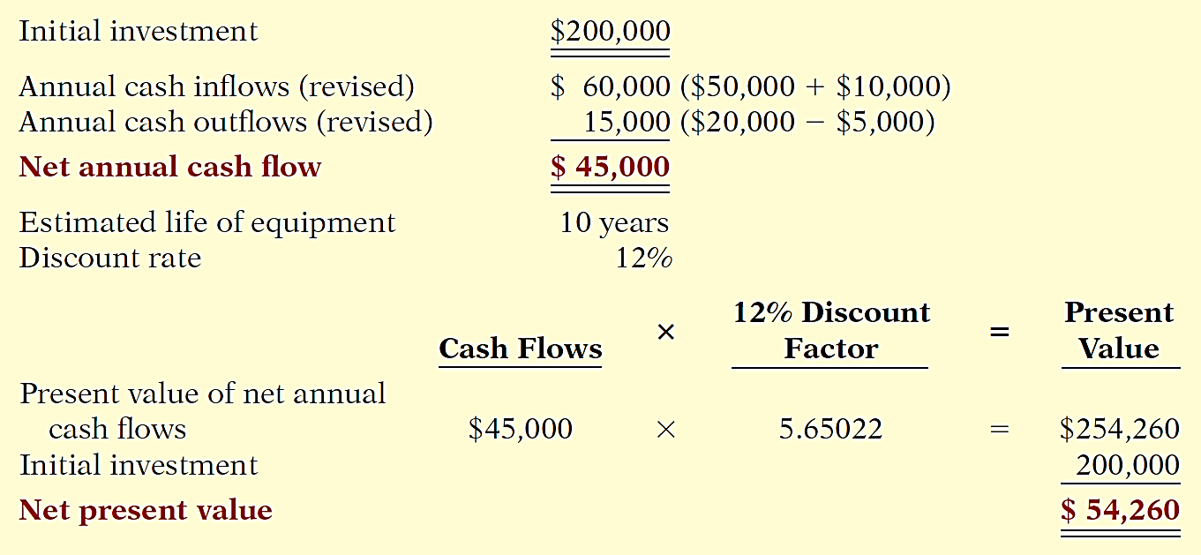
Intangible Benefits
Berg would accept the project.

Slide 36
Profitability Index for Mutually Exclusive Projects
Proposals are often mutually exclusive.
Managers often must choose between various positive-NPV projects because of limited resources.
Tempting to choose the project with the higher NPV.

Slide 37
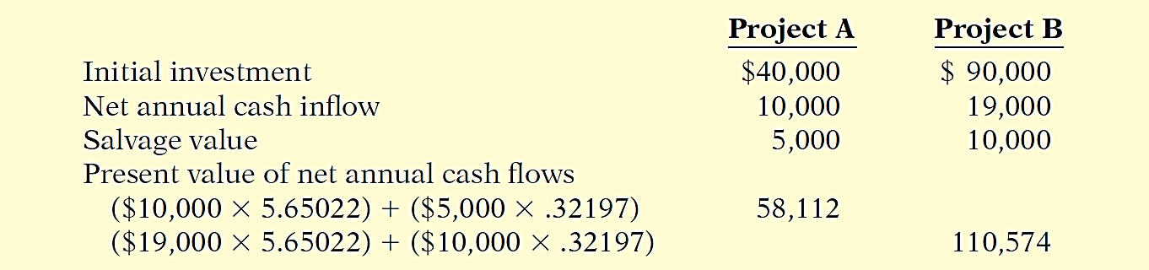
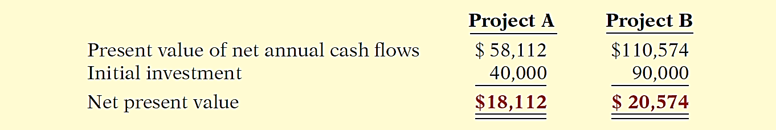
Profitability Index for Mutually Exclusive Projects
Illustration: Two mutually exclusive projects, each assumed to have a 10-year life and a 12% discount rate.

Slide 38
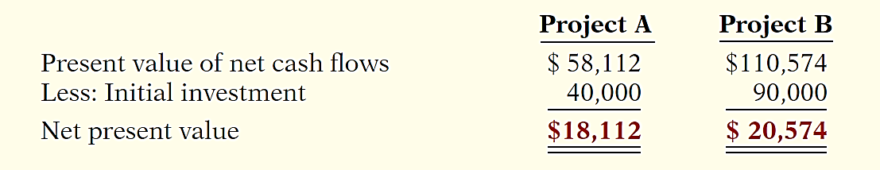
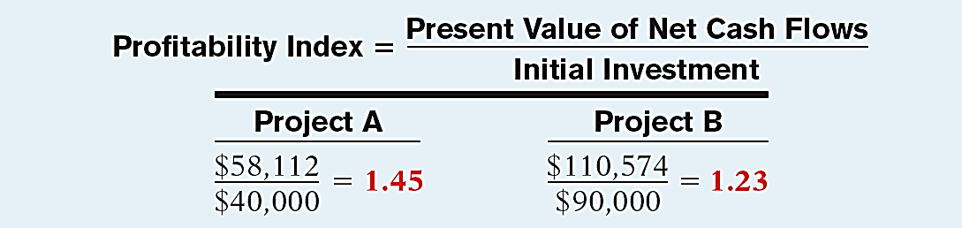
Profitability Index for Mutually Exclusive Projects
Illustration: One method of comparing alternative projects is the profitability index.

Slide 39
Risk Analysis
A simplifying assumption made by many financial analysts is that projected results are known with certainty.
Projected results are only estimates.
Sensitivity analysis is used to deal with uncertainty.
Sensitivity analysis uses a number of outcome estimates to get a sense of the variability among potential returns.

Slide 40
Post-Audit of Investment Projects
Performing a post-audit is important – how well a project’s actual performance matches original projections.
If managers know that their estimates will be compared to actual results, they will be more likely to submit reasonable and accurate data when making investment proposals.
Provides a formal mechanism to determine whether existing projects should be supported or terminated.
Improve future investment proposals.

Slide 41
Profitability Index for Mutually Exclusive Projects
Question
Assume Project A has a present value of net cash inflows of $79,600 and an initial investment of $60,000. Project B has a present value of net cash inflows of $82,500 and an initial investment of $75,000. Assuming the projects are mutually exclusive, which project should management select?
Project A.
Project B.
Project A or B.
There is not enough data to answer the question.

Slide 42
Learning Objective 25-4
Internal Rate of Return (IRR) Method

Slide 43
Outline
Internal rate of return (IRR) method
Comparing discounted cash flow methods

Slide 44
Internal Rate of Return Method
Differs from the net present value method in that it finds the interest yield of the potential investment.
Internal rate of return (IRR) - interest rate that will cause the present value of the proposed capital expenditure to equal the present value of the expected net annual cash flows (NPV equal to zero).
How does one determine the internal rate of return?

Slide 45
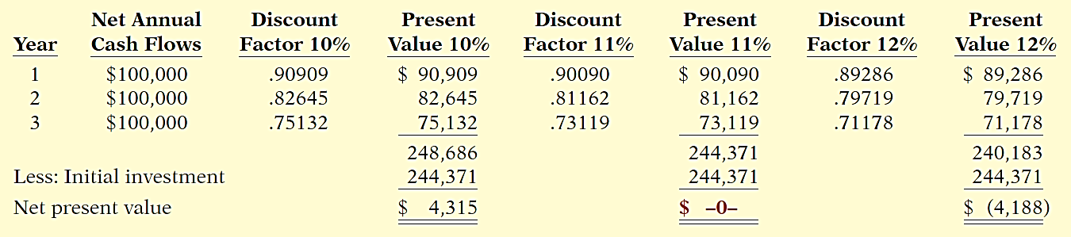
Internal Rate of Return Method
Illustration: Stewart Shipping Company is considering the purchase of a new front-end loader at a cost of $244,371. Net annual cash flows from this loader are estimated to be $100,000 a year for three years. Determine the internal rate of return on this front-end loader.

Slide 46
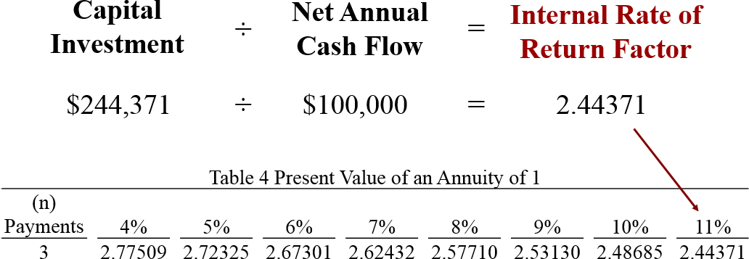
Internal Rate of Return Method
An easier approach to solving for internal rate of return when net annual cash flows are equal.

Slide 47
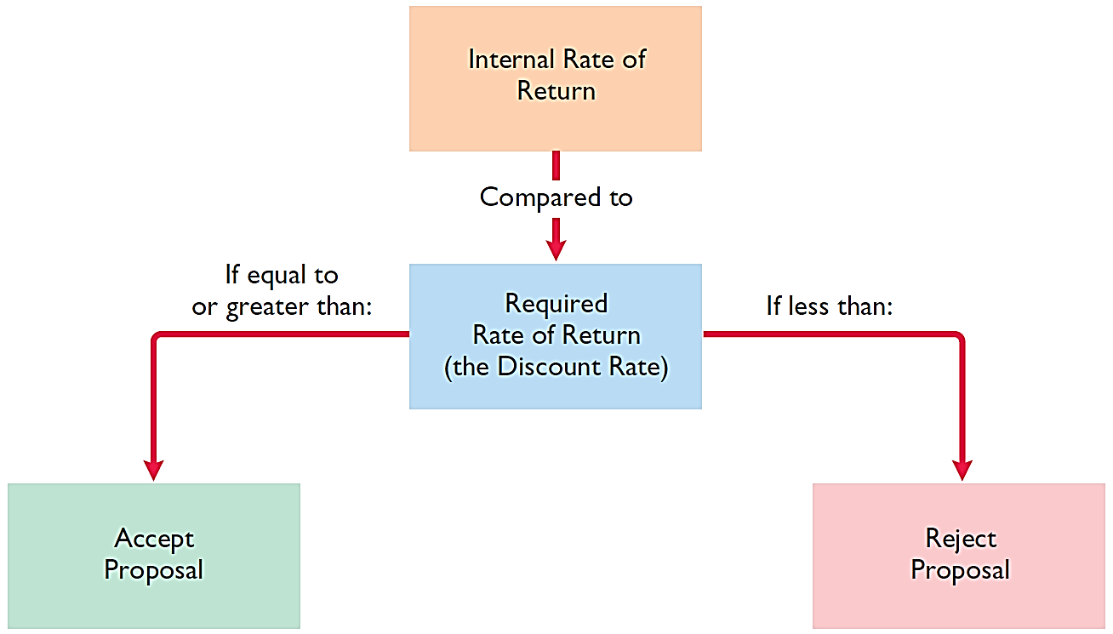
Internal Rate of Return Method

Slide 48
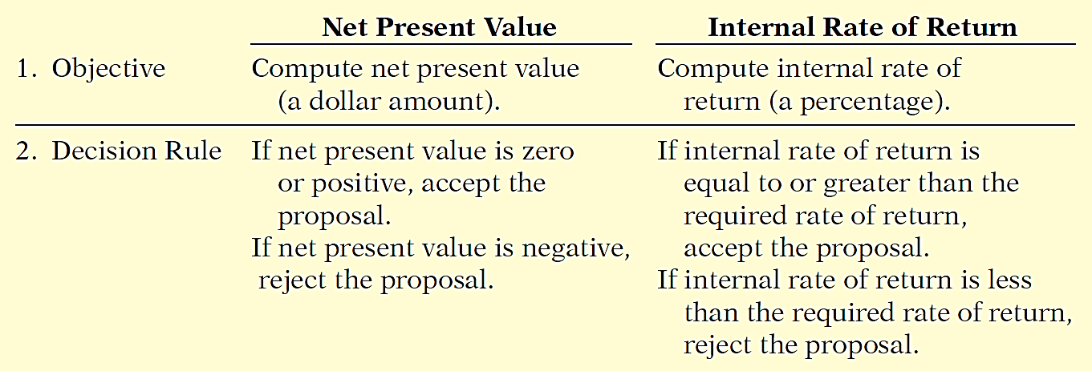
Comparing Discounted Cash Flow Methods
Either method will provide management with relevant quantitative data for making capital budgeting decisions.

Slide 49
Learning Objective 25-5
Annual Rate of Return Method

Slide 50
Outline
Annual rate of return

Slide 51
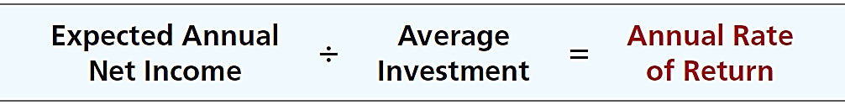
Annual Rate of Return
Based directly on accrual accounting data rather than on cash flows
Indicates the profitability of a capital expenditure by dividing expected annual net income by the average investment.

Slide 52
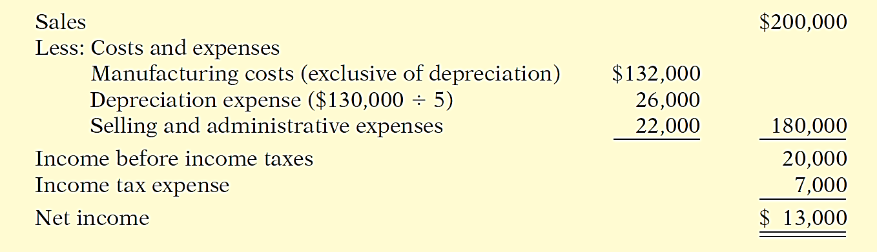
Annual Rate of Return
Illustration: Reno Company is considering an investment of $130,000 in new equipment. The new equipment is expected to last five years and have zero salvage value at the end of its useful life. Reno uses the straight-line method of depreciation.

Slide 53
Annual Rate of Return
130,000 + 0
= $65,000
2
Expected annual rate of return
$13,000
= 20%
$65,000
A project is acceptable if its rate of return is greater than management’s required rate of return.

